Slide 1
Emojify - Create Your Own Emoji
Submitted in the partial fulfillment for the award of the degree of
BACHELOR OF ENGINEERING
IN
COMPUTER SCIENCE AND ENGINEERING (hons.)BIG DATA AND ANALYTICS
Submitted by:
Gurleen Kaur
20BCS3839
Varun Singh
20BCS3800
Under the Supervision of:
Mrs. Shweta Jain
Department of AIT-CSE
DISCOVER . LEARN . EMPOWER

Slide 2
Outline
Introduction to Project
Problem Formulation
Objectives of the work
Methodology used
Results and Outputs
Conclusion
Future Scope
References

Slide 3
Introduction to Project
Emojis are nothing but tiny pictures of emotions or we can also refer them as stickers. Emojis are the present-day channel of chatting with one another online. Emojis/Avatars have completely changed the way people used to communicate and now emojis are ruling the online mode of conveying the news or messages. Emojis are becoming the new language, which is being used by people all over the world. Simply, it is the emerging language of universe. Emojis - to enrich the written form of communication.
The reason of emojis getting used world wide is the simplicity they have in themselves. As already mentioned they are just little pictures like cartoons but they convey all the information about someone’s state of mind, someone’s reaction, or someone’s response that simple text message can’t pass to other individual’s message sitting on the other side of medium in communication. Straightforwardly, emojis are nonverbal method of expressing feelings of a person.
The creator of emoji, Shigetaka Kurita, wanted to enable communication of “thoughts or emotions without inspiring strong likes or dislikes in the way a picture might”. An emoji is a graphic symbol, ideogram, which represents not only facial expressions, but also concepts and ideas, such as celebration, weather, vehicles and buildings, food and drink, animals and plants, or emotions, feelings, and activities.
Every so often, text messages are not proved to transmit the emotions sender wants to show to the receiver. In the rescue of text messages, emojis are there! Emojis can reflect ideas, state of mind, emotions or sentiments effectively and precisely. The logical formula that i use to state emojis is:
Emoji = nonverbal communication + current state of mind.

Slide 4
Since it is nonverbal so user doesn’t have to write long-long paragraphs to express in which state he or she is! Hence, it is also not very tedious task to do so, just one click on the emoji that matches with the user’s present state of feeling and there he/she goes! In support of my point, i would like to point out famous character’s in history of Television shows.
Charlie Chaplin had not spoken a single word in his entire TV show and yet he was able to make everyone laugh by expressing his emotions through his facial formation that everyone loved. He believed that his comedy would not translate to audiences via having talk. He did believed that emotions are best way to communicate.
Mr. Bean, (a cartoon character loved by children) youngsters and also by adults. It has been characterized to only make facial expressions and not speak a word throughout the cartoon show, still everyone including children, youngsters and adults are able to figure it out what he is conveying.
Above two points shows the power of facial expressions, the strength they carry to communicate the sentiments and feelings.
Emojis are available for use in almost all the digital platforms like WhatsApp, Facebook and a lot more. After looking at the increasing interest and affection of present generation people in communicating through ways that consists of emojis, the organizations have modified their way of surveying the people. The organizations and industries have started to take feedback’s in form of emojis. Emojis are getting turned into global language and there are researches going on to build emoji-driven storytelling.
In a nutshell, it is committed that present generation love to communicate through emojis and avatars. So we have developed our project which is supposed to build our own customized emojis similar to human face formation. Our Project is including seven human expressions that consists of emotions such as happy, neutral , sad, surprise, angry, fearful, disgusted.

Slide 5
Problem Formulation
The problem formulation for this project can be broken down into following steps:
Data Collection: Collect a large dataset of images that contain human faces displaying different emotions, such as happiness, sadness, anger, surprise, fear and disgust.
Preprocessing:Preprocess the input images to ensure that they are in a suitable format for analysis. This may include re-sizing, cropping and coverting images to grayscale.
Emotion Detection: Develop and algorithm or use existing models to detect the primary emotion displayed in the input image. This may involve using computer vision techniques, such as feature extraction and machine learning, to analyze the facial expressions, body language and other visual cues.
Emoji Generation: Develop a system that can generate an appropriate emoji that reflects the detected emotion. This may involve using pre-trained models or training new models to match the detected emotion with corresponding emoji.
User Interface: Design a user interface that allows users to upload an image, analyze it for emotions, and display the corresponding emoji. This may involve developing a web application, mobile application, or desktop application that integrates the emotion detection and emoji generation algorithms.
Testing and Evaluation: Test the system using a diverse range of images and evaluate its performance based on metrics such as accuracy, speed, and user satisfaction.

Slide 6
Objectives of the Work
The objective of the Emojify Project is to develop a system that can analyze an input image and generate an appropriate emoji that reflects the emotions conveyed in the image. This project aims to enhance communication and expression by providing a fun and intuitive way for users to convey their emotions through digital means. By using computer vision techniques and machine learning algorithms, the Emojify project can help bridge the gap between human emotions and digital communication, allowing users to convey their emotions more accurately and effectively. Overall, the objective of this project is to create a user friendly and accurate system that can generate emojis that accurately reflect the emotions displayed in input, thereby enhancing digital communication.

Slide 7
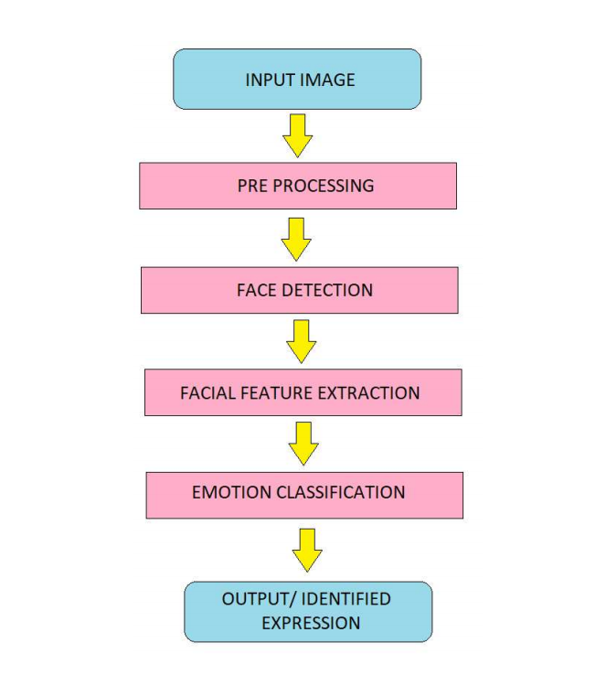
Methodology Used

Slide 8
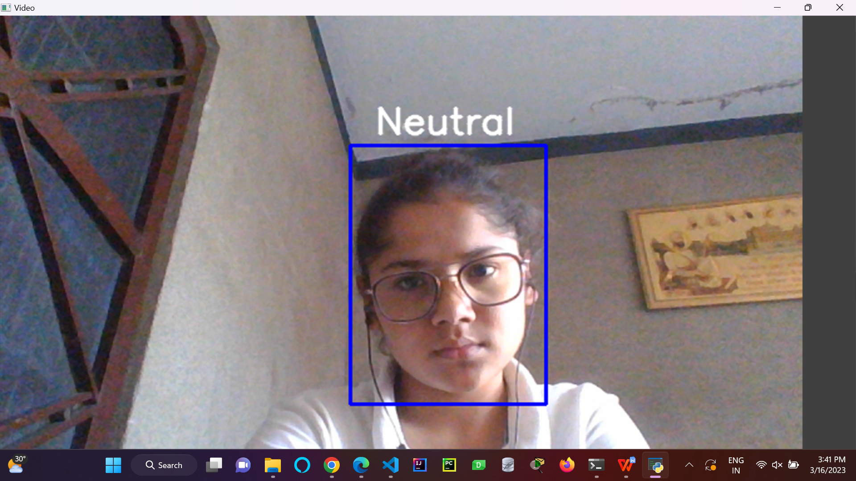
Results after Training the Algorithm

Slide 9
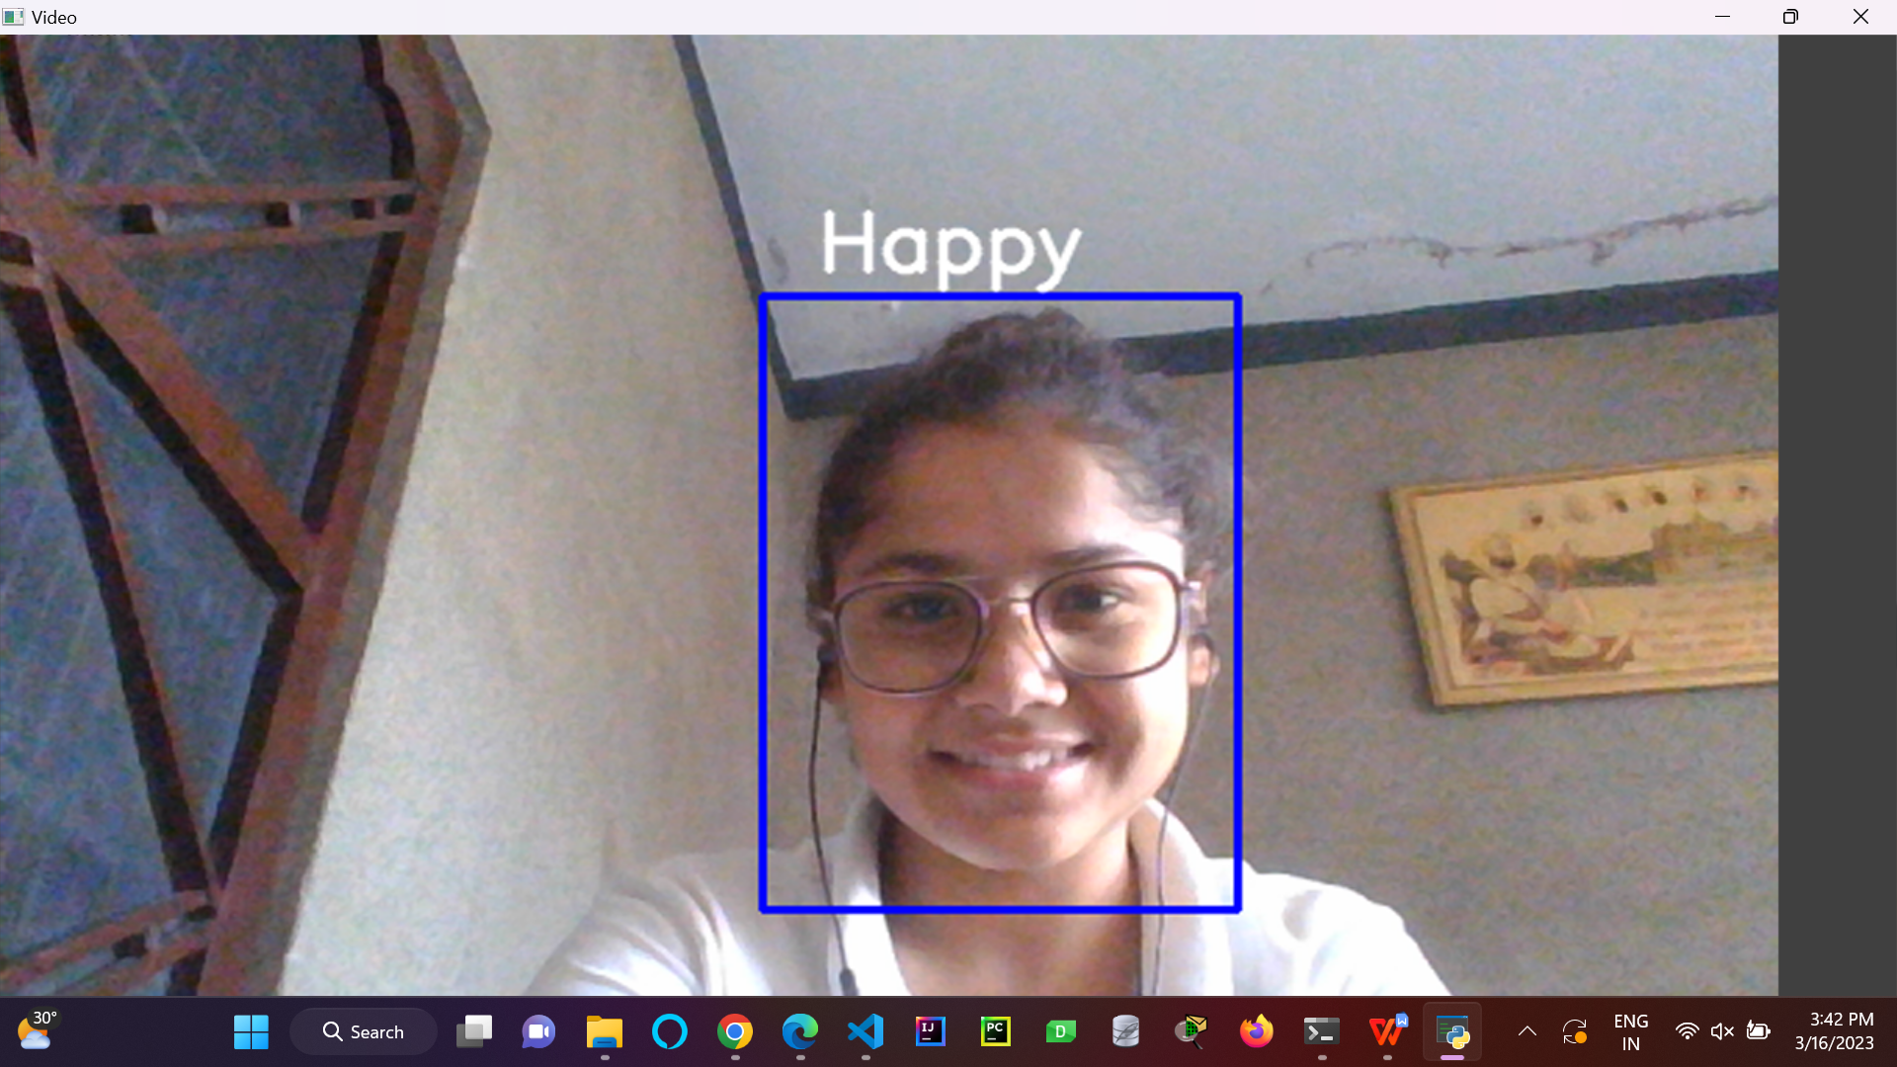

Slide 10
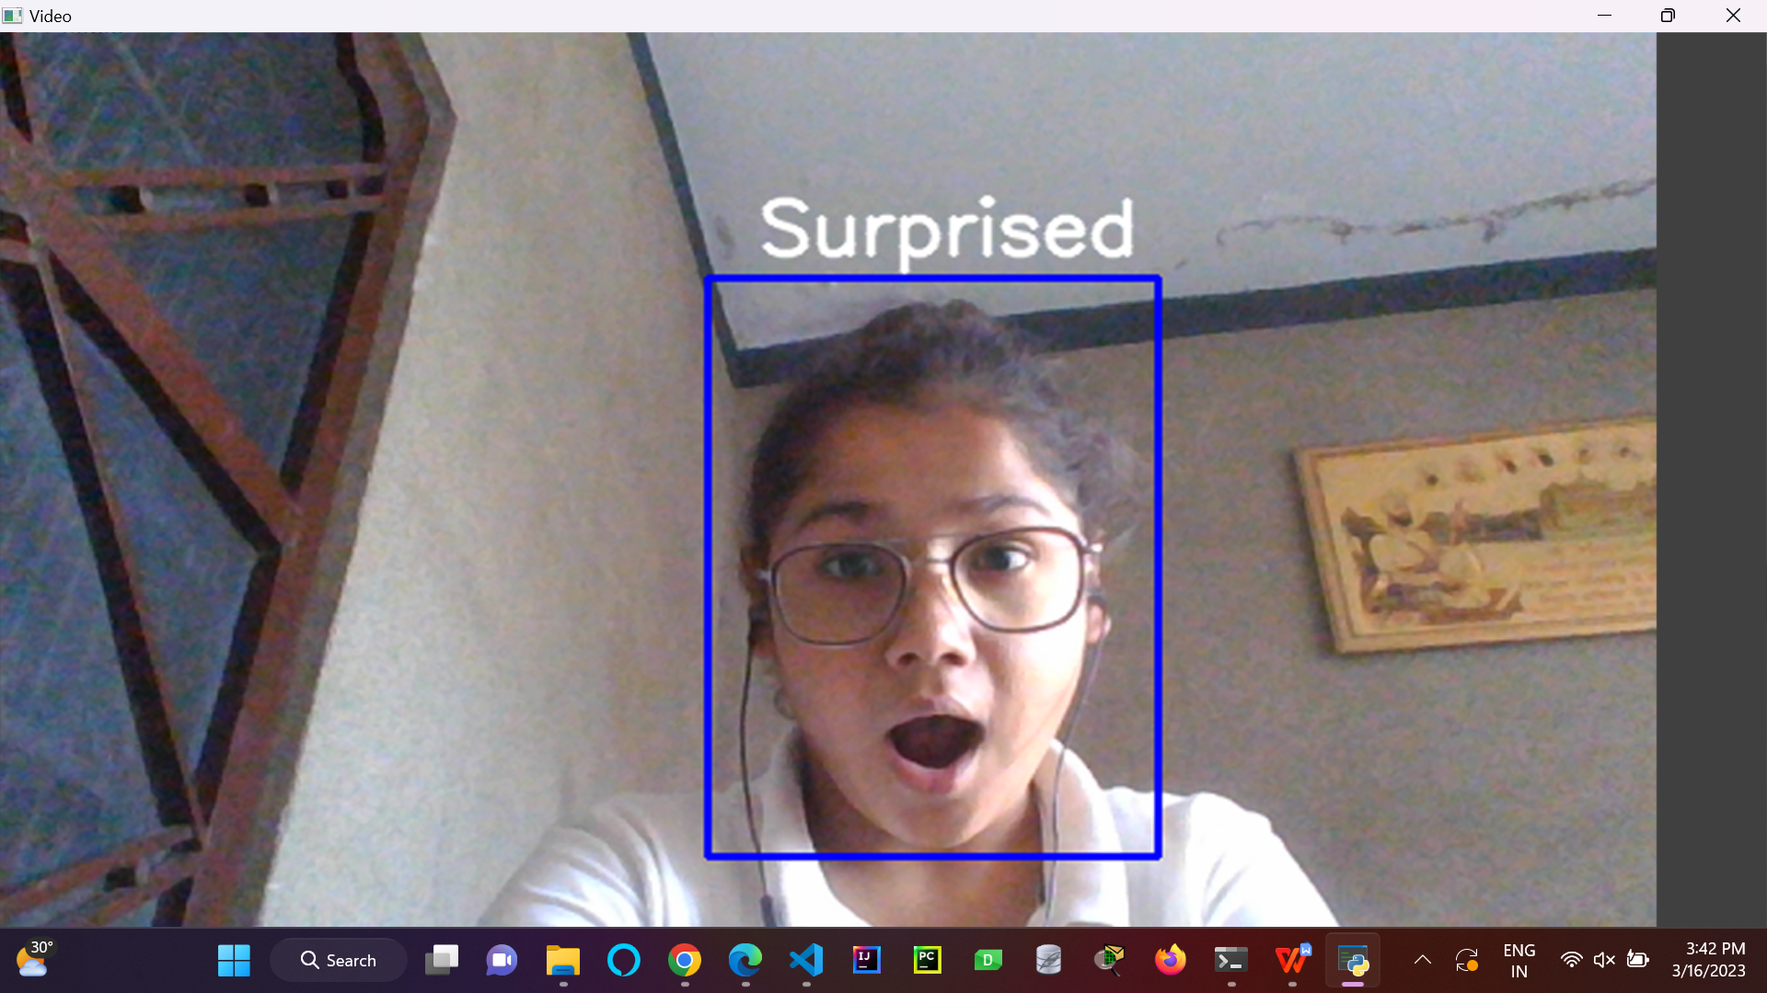

Slide 11
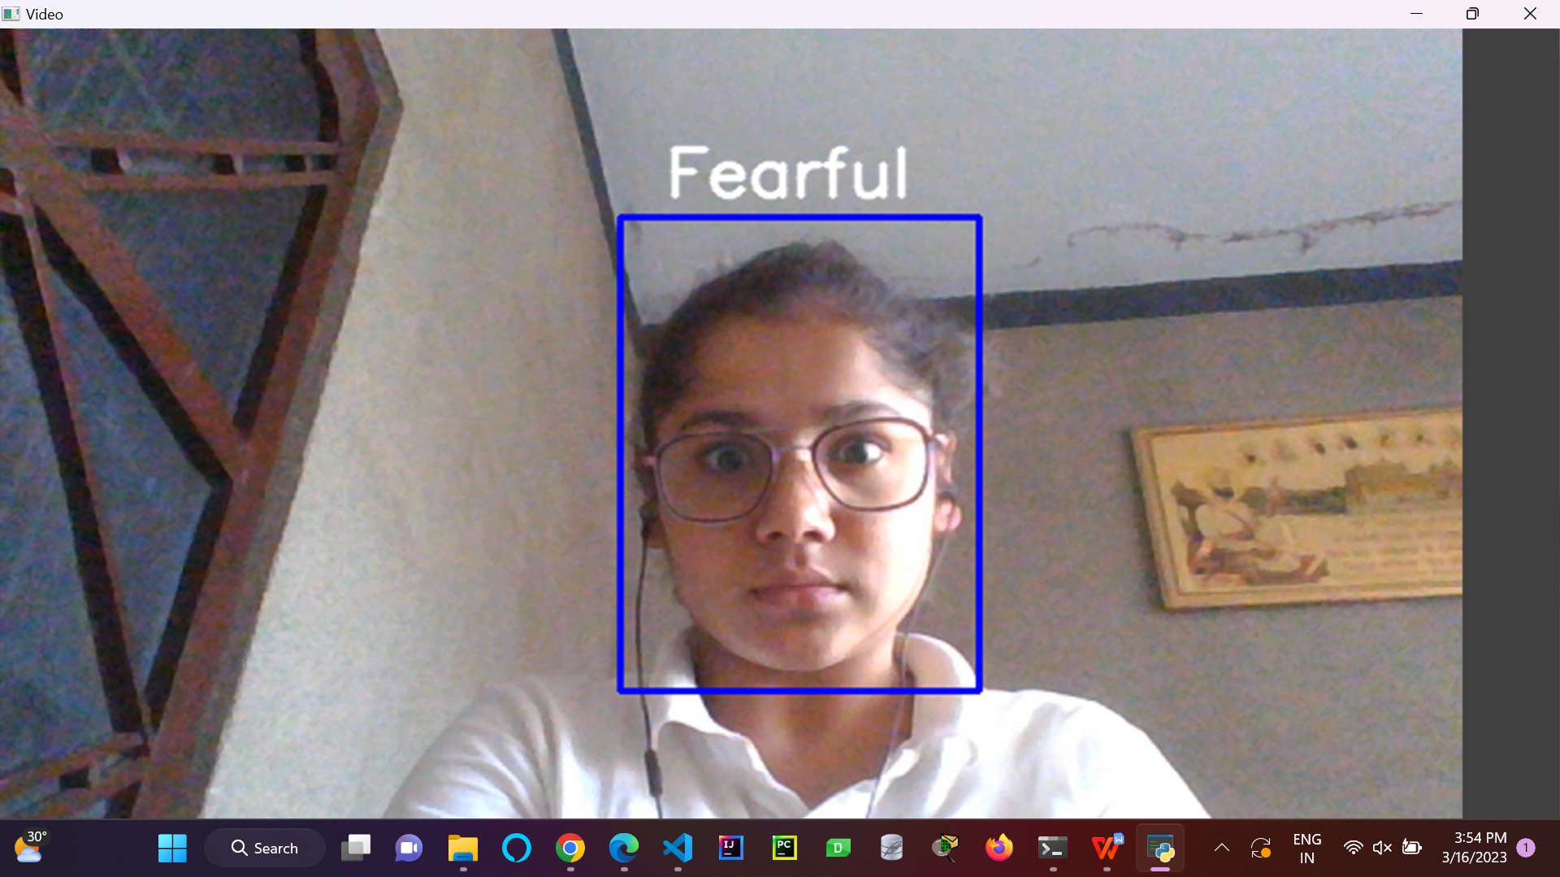

Slide 12
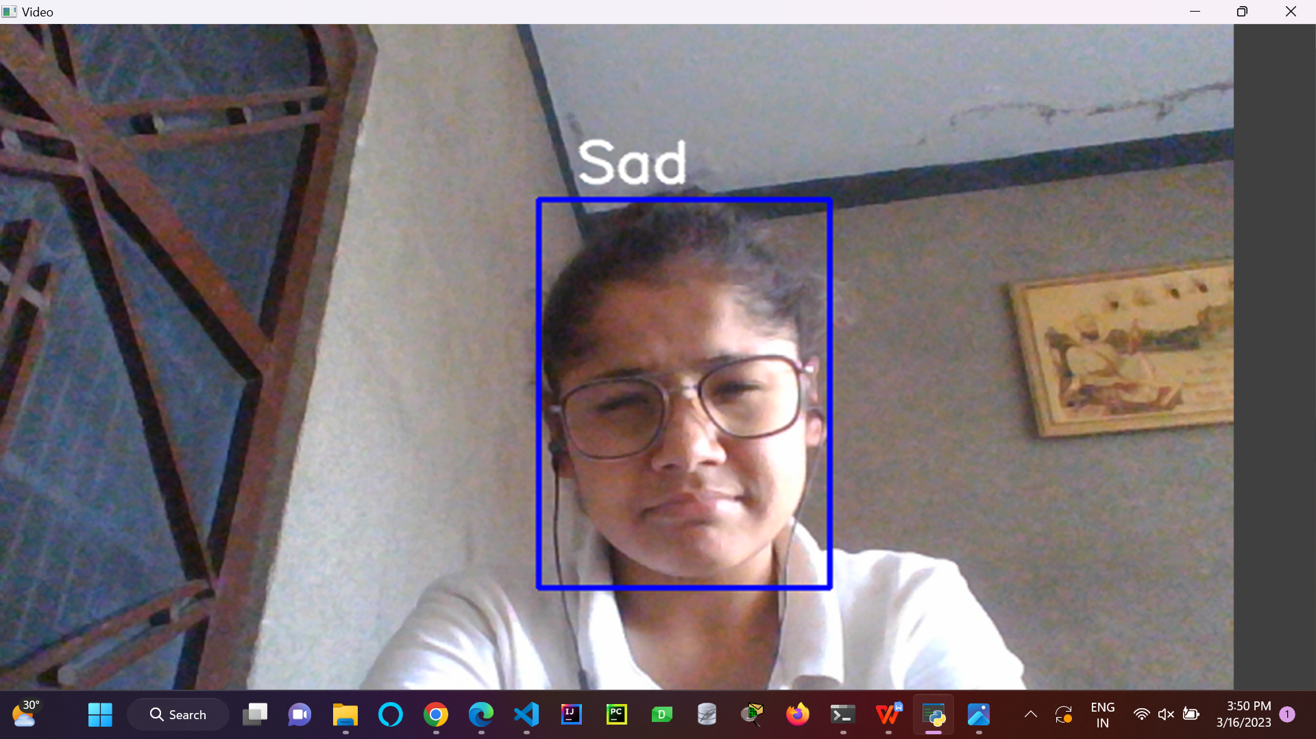

Slide 13
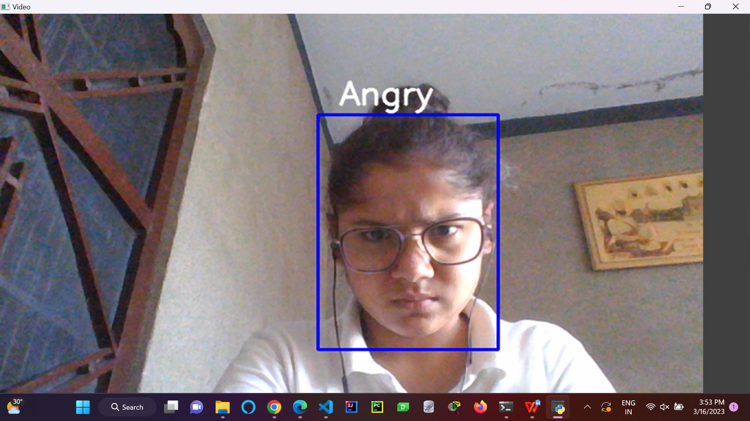

Slide 14
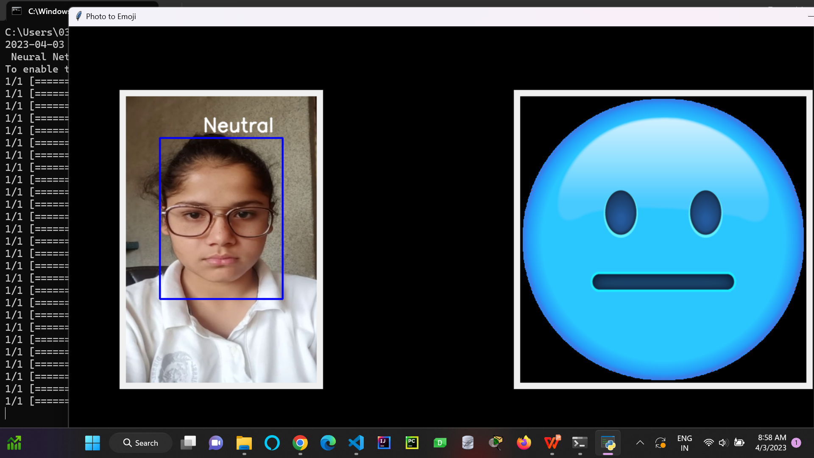
Results after Associating Emojis with Face Expressions

Slide 15


Slide 16
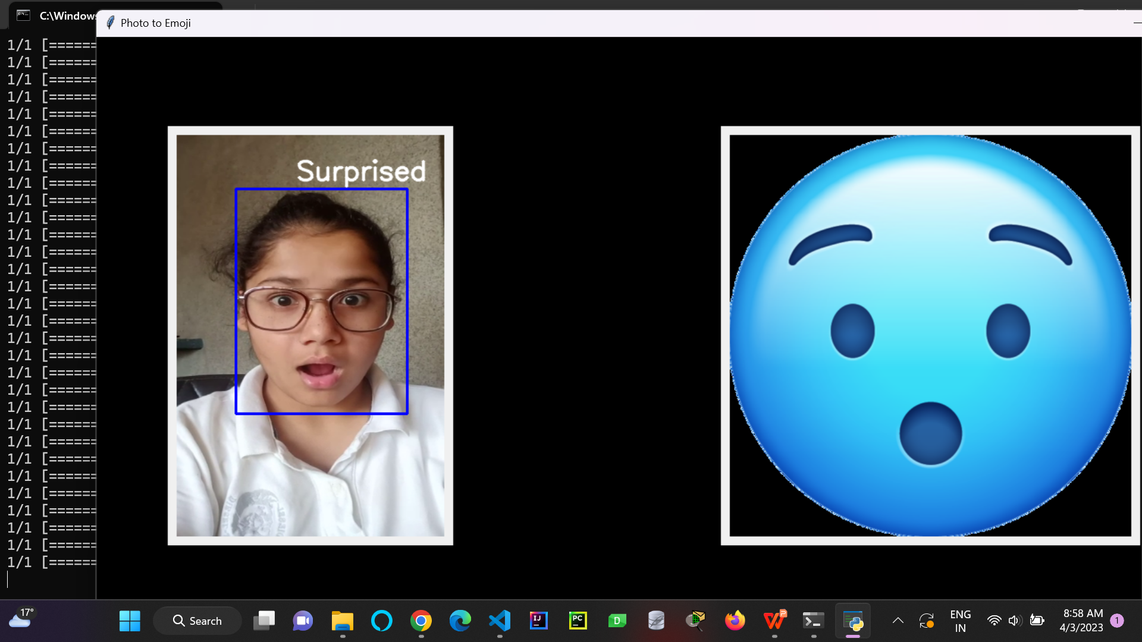

Slide 17
Conclusion
Emojis are a growing and evolving language that is going to compete with the traditional rules that defines the written mode of communication. But, it should also be keep in mind that as an image of nonverbal gestures is for spoken communication, so is an image of emoji for written communication. It complements the written mode by covering the vacancy in text communicated through a smile, or a smirk, or any other emotion. Thus, we come to understand that the use of emojis are here to stay for a long time. But, whether they change the tradition of written, formal language or render with it to bring a hybrid form of communication is yet to be seen.

Slide 18
Future Scope
The Emojify Project has significant potential for future development and expansion. Some potential future scope for the Emojify project include:
Improved Accuracy: As technology continues to advance, there is the potential to improve the accuracy of Emojify system. This could involve using more advanced machine learning algorithms, incorporating additional data sources, or refining the current algorithms to improve their performance.
Customized emojis: The Emojify project could be expanded to allow users to create their own customized emojis that reflect their personal style and preferences. This could involve developing a user interface that allows users to select from a range of options, such as facial features, colors and expressions, to create their own personalized emojis.
Integration with social media: The Emojify project could be integrated with social media platforms, allowing users to quickly and easily add emojis to their posts and messages. This would enhance digital communication by providing users with fun and intuitive way to convey their emotions and reactions.

Slide 19
References
[1] Andral M. and Larroque A. 2016. “The emojis consumer perception in the online advertising” Halmstad University Bachelor’s Valiation
[2] Bliss-Carroll N.L. 2016. “The Nature, Function, and Value of Emojis as Contemporary Tools of Digital Interpersonal Communication” Doctoral Dissertation, Gardner-Webb University
[3] Chairunnisa S. and Benedictus A. S. 2017. “Analysis of Emoji and Emoticon Usage in Interpersonal Communication of Blackberry Messenger and WhatsApp Application User” International Journal of Social Sciences and Management Volume 4, Issue 2: 120-126
[4] Eisenstein, J. and Pavalanathan, U. (2015). “Emoticons vs. Emojis on Twitter: A Casual Inference Approach” CoRR abs/1510.08480
[5] Gullberg K. 2016. “Laughing Face with Tears of Joy: A Study of the Production and Interpretation of emojis among Swedish University Students” Bachelor Thesis, Lund University
[6] Kyle L. K., Malone S. A. and Wall H. J. 2017. “Emojis: Insights, Affordances and Possibilites for Psychological Science” Trends in Cognitive Sciences Volume 21, Issue 2 : 66-68
[7] Kelly, R. and Watts, L. (2015). “Characterising the Inventive Appropriation of Emoji as Relationally Meaningful in Mediated Close Personal Relationships” Experiences of Technology Appropriation: Unanticipated Users, Usage, Circumstances, and Design

Slide 20
[8] Lu X., Ai W., Liu X., Li Q., Wang N., Huang G. and Mei Q. 2016. “Learning from the Ubiquitous Language: An Empirical Analysis of Emoji Usage of Smartphone Users” Proceedings of the 2016 ACM International Joint Conference on Pervasive and Ubiquitous Computing : 770-780 Emojis: The Language of the future? – A Literature Review 139
[9] Negishi, M. (2014). “Meet Shigetaka Kurita, The Father of Emoji” The Wall Street Journal https://blogs.wsj.com/japanrealtime/2014/03/26/meet-shigetakakurita-the-father-of-emoji/ (Accessed September 1, 2017)
[10] Novak, P. K., Smailović, J., Sluban, B. and Mozetiĉ, I. (2015). “Sentiment of Emojis” CoRR abs/1509.07761
[11] Pele A. 2016. “From English to Emojis: A New, Simpler, Digital Language” The 11th International Conference on Virtual Learning ICVL 2016 :396-401
[12] Stark, L. and Crawford, K. (2015). “The Conservatism of Emoji: Work, Affect and Communication” Social Media+Society 1.2: 2056305115604853
[13] Tian Y., Galery T., Dulcinati G., Molimpakis E. and Sun C. 2017. “Facebook Sentiment: Reactions and Emojis” Proceedings of the Fifth International Workshop on Natural Language Processing for Social Media 10.18653/v1/W17-1102 : 11-16
[14] Walther, J. B. and D’Addario, K. P. (2001). “The Impacts of Emoticons on Message Interpretation in Computer-Aided Communication” Social Science Review Volume 19, Issue 3: 324-327
[15] Zhou, R., Hentschel, J. and Kumar N. (2017). “Goodbye Text, Hello Emoji: Mobile Communication on WeChat in China” Proceedings of the 2017 CHI Conference on Human Factors in Computer Systems :748-759
[16] Zhu, X. (2015). “A Symbolism Study of Expression in Text-Based Communication” Iowa State University Graduate Theses and Dissertations

